Slide 1
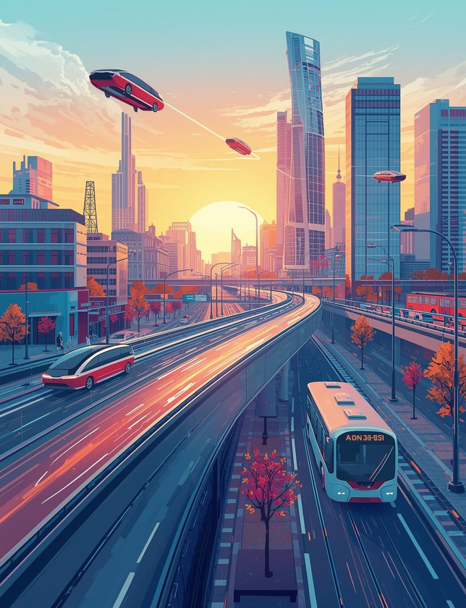


RESOLVE IT-
Public transport grievance and feedback management system
BY DEEPTHI K Y

Slide 2
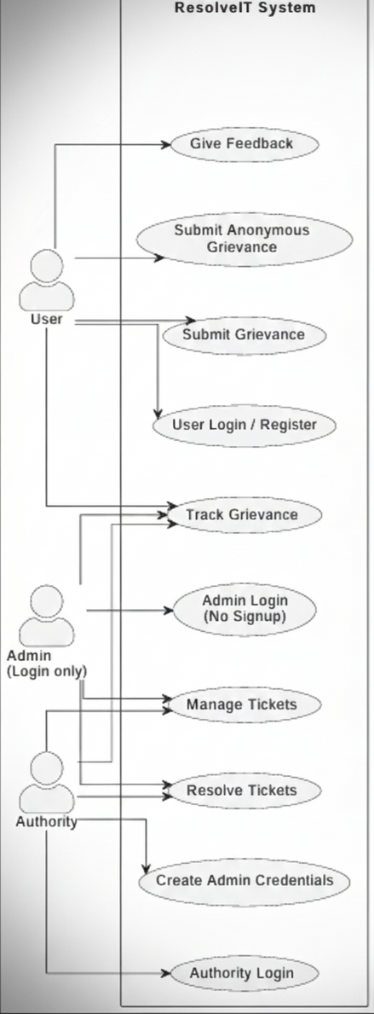
USECASE DIAGRAM
The Use Case Diagram shows how different actors interact with the system and what functionalities are available to each.
It clearly defines:
Boundaries of the system
Responsibilities of each actor
Main features offered to users, admins, and authorities

Slide 3
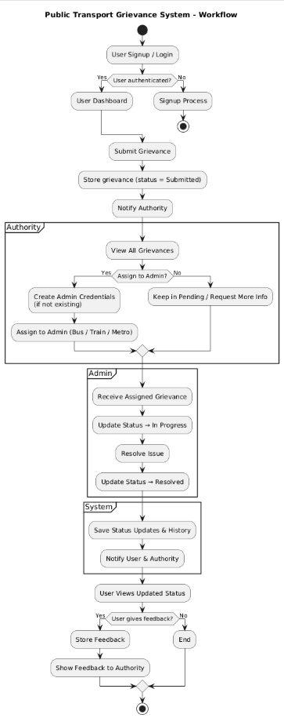
WORKFLOW DIAGRAM
This workflow represents the complete life-cycle of a grievance in the system:
User Login / Signup
Submit Grievance → Stored in Database
Authority gets notified
Authority reviews grievance
Assigns to Admin
OR keeps pending
Admin receives assignment
Admin updates grievance status
In Progress
Resolved
User is notified & views updated status
User submits feedback
Authority can also view feedback
This diagram ensures clarity on how information flows between user → authority → admin → user.

Slide 4
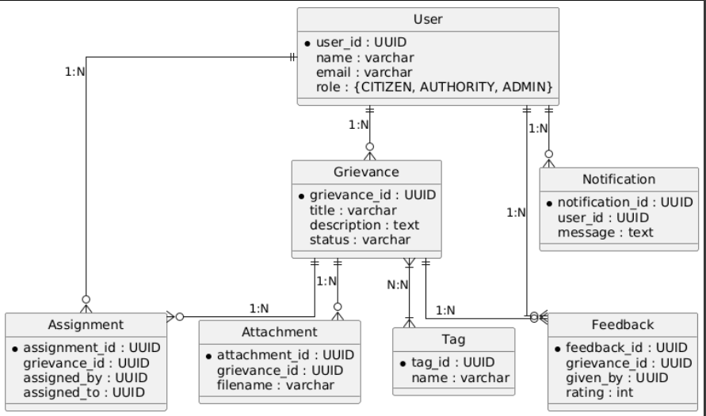
ENTITY-RELATIONSHIP DIAGRAM
The ER diagram represents the data model used in the system.
It highlights key entities and their relationships.
Entities
User – Stores user details (Citizen, Authority, Admin)
Grievance – Stores complaint details
Assignment – Stores assignment history
Attachment – Files uploaded with grievances
Feedback – Ratings and comments by users
Notification – System messages
Tag – Categorization labels

Slide 5
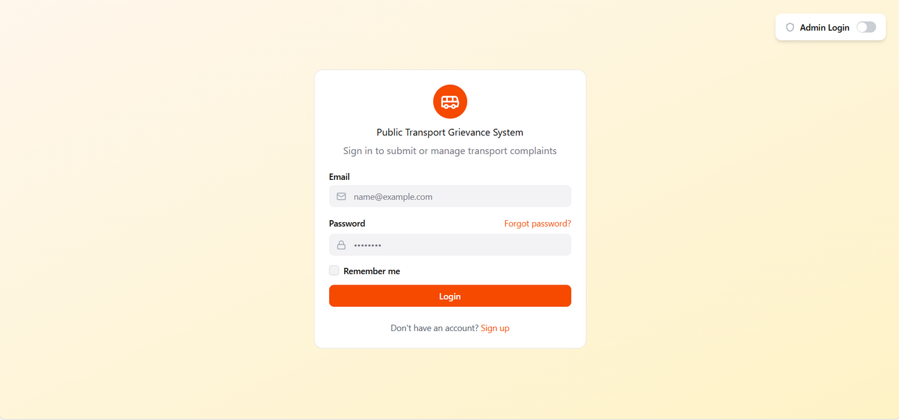
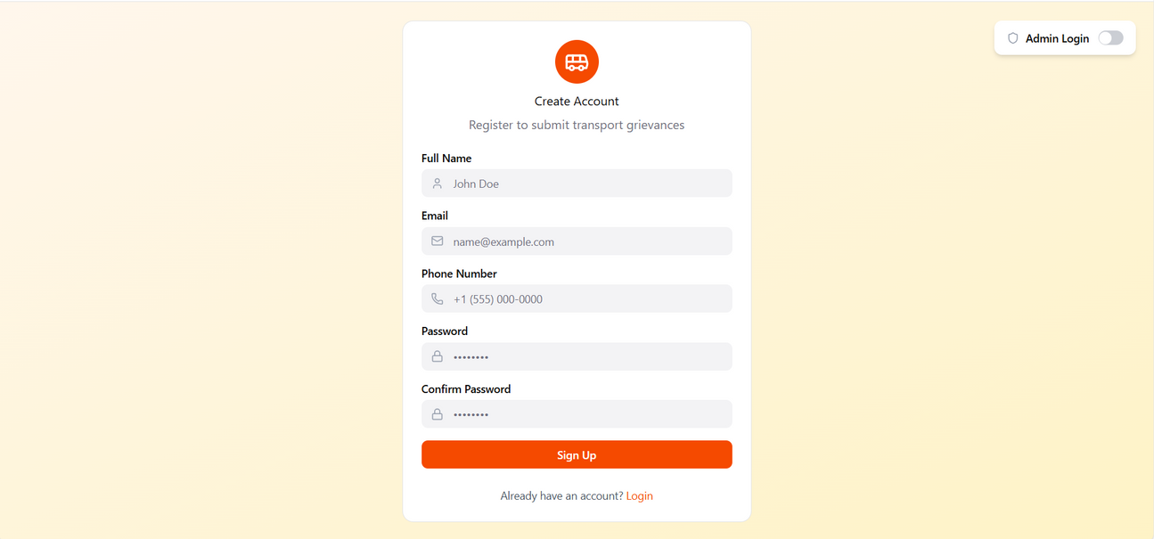
UI/UX - USER LOGIN

Slide 6
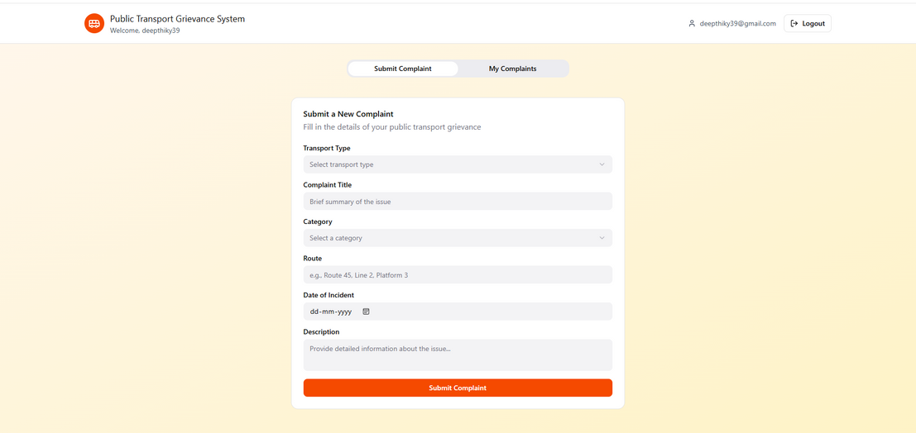
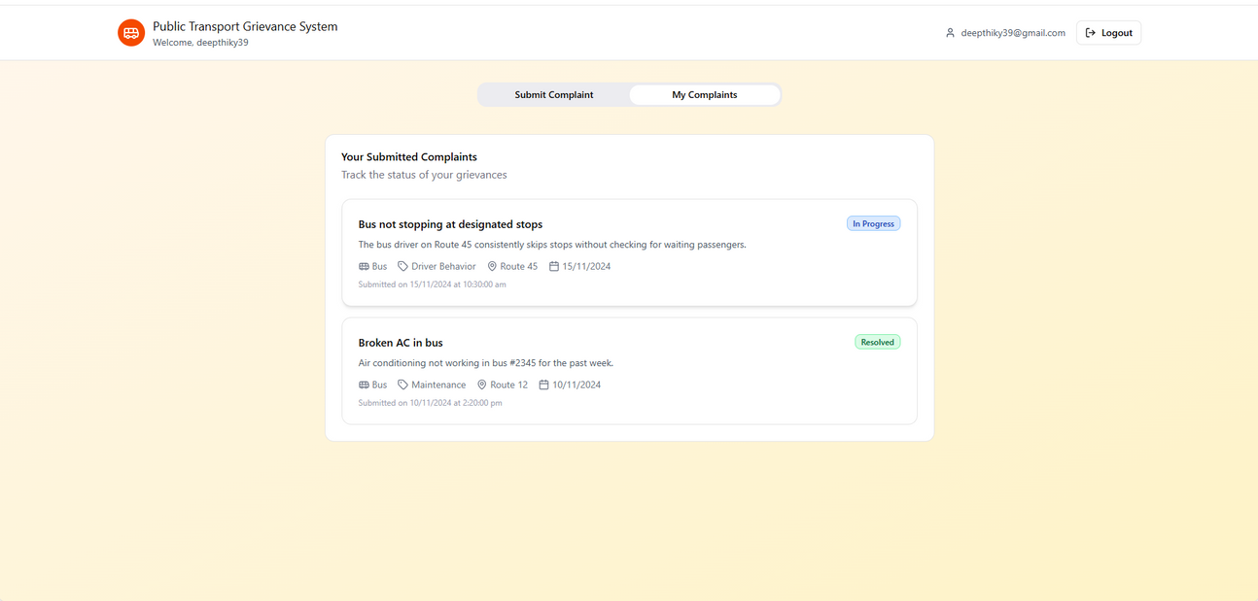
UI/UX-USER DASHBOARD

Slide 7
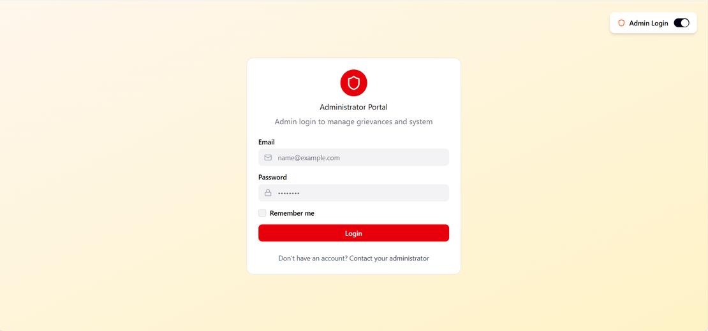
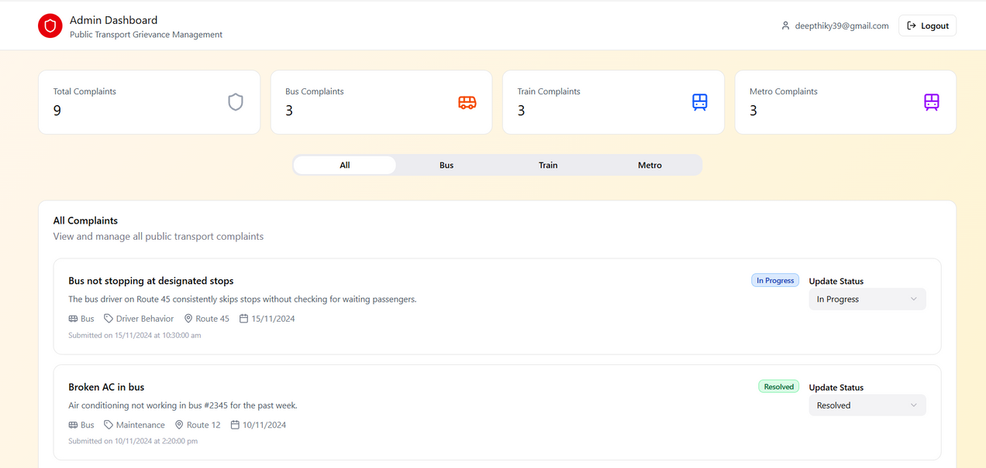
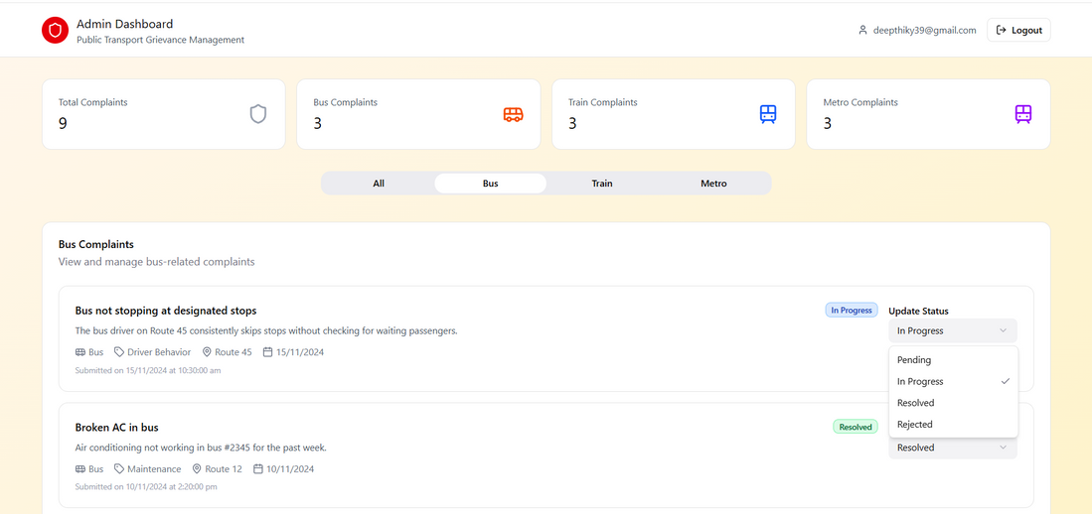
UI/UX-ADMIN LOGIN & DASHBOARD

Slide 8
TECHNOLOGIES :
UI-html,css,js
Backend-java,springboot
Database-mysql
Tools-vscode,liveserver extensions,devtools

Slide 9
FURTHER WORK
CONNECT FRONTEND TO BACKEND
ADD DATABASE
IMPLEMENT OTP VALIDATION
ADD FILE UPLOAD
REAL-TIME NOTIFICATIONS
ANALYICS DASHBOARD FOR ADMINISTRATORS
IMPROVE SECURITY
Mobile app

Slide 10
THANK YOUU

